Slide 1

Layout and Widget part 1
Emerging Technology : Flutter
Week 3
Program Studi Teknik Informatika
Fakultas Teknik – Universitas Surabaya

Slide 2

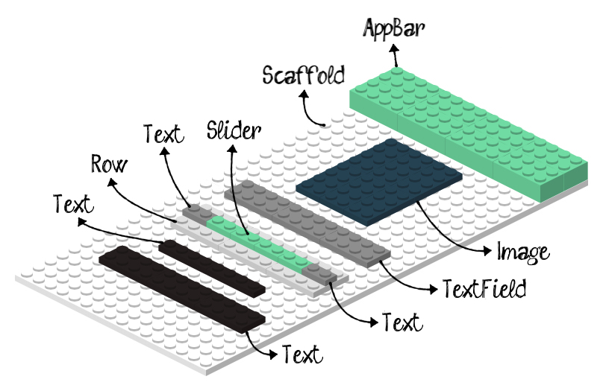
What is Widget
To build a modern, reactive UI, Flutter uses widgets that are drawn using Flutter’s own rendering engine (Skia)
Imagine widgets as LEGO blocks:
Objects are created by adding some blocks
The look and behavior can be altered by adding different kind of blocks
Each widget in Flutter is immutable. That means once it’s created, it cannot change. Instead of modifying a widget, Flutter rebuilds parts of the UI with new widgets whenever the state changes.
Placing widgets builds a widget tree

Slide 3
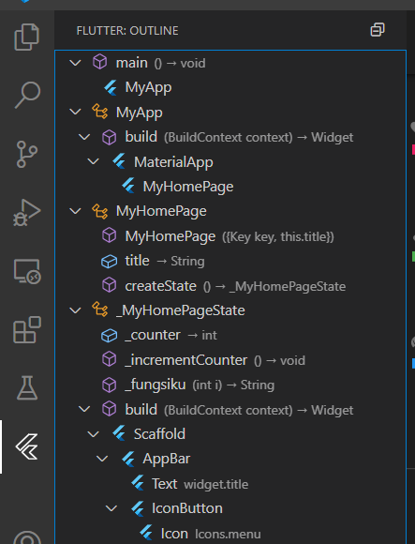
Widget Tree
In Flutter, everything is a widget
Widget tree is a structure that represents how our widgets are organized. For comparison, Web pages have a DOM; Flutter have a Widget Tree.

Slide 4

SINGLE CHILD LAYOUT WIDGET
01

Slide 5
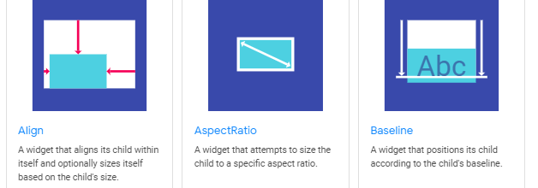
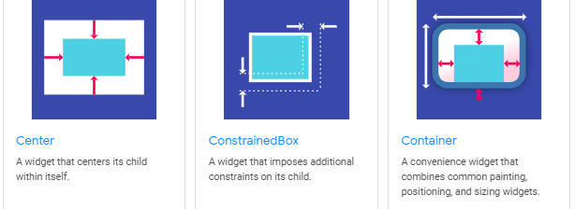
Single Child Layout Widget

Slide 6
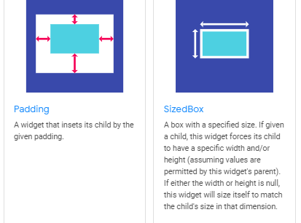
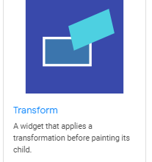
Single Child Layout Widget (2)

Slide 7
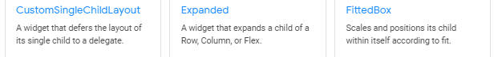
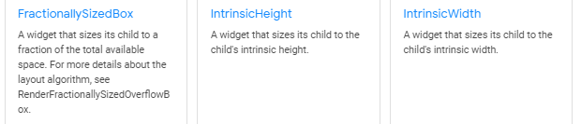
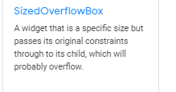
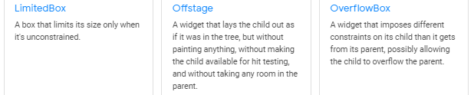
Single Child Layout Widget (3)

Slide 8
Align Layout
Use this widget to align the child according to the alignment
Its size may adjust automatically based on the child’s size
Alignment can be set to any named position (bottomCenter, bottomRight, bottomLeft, center, centerLeft, centerRight, topCenter, topRight, topLeft) or defining our own alignment
Single child
Align(
alignment: Alignment.center,
child: Text('Ini Align’),
)
Align( alignment: Alignment(0.2, 0.6), child: Text( ‘blablabla’), )

Slide 9
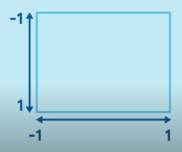
Alignment
Valid range: -1.0 to 1.0
X = -1.0 means the left edge of the child is aligned with the left edge of the parent
X = 1.0 means the right edge of the child is aligned with the right edge of the parent
Any values in-between will be interpolated/extrapolated linearly

Slide 10
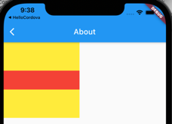
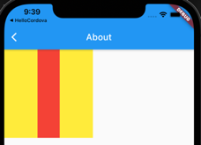
AspectRatio Layout
This widget will attempt to size its child to a specific aspect ratio:
It first tries the largest with permitted by layout constraints (width/height)
Height is then set by applying aspect ratio to the width
If it fails, it will select a size that conforms to the constraints (if any)
Container(
color: Colors.yellow,
alignment: Alignment.center,
width:200.0,
height: 200.0,
child: AspectRatio(
aspectRatio: 4/1,
child: Container(
color:Colors.red
)
)
)
4/1 1/4

Slide 11
Container Layout
A convenience widget that combines common painting, positioning, and sizing widgets:
Surrounds the child with padding (inflating it first if a decoration is present)
Applies additional constraints to the padded extend to the width and height as constraints, when present
Surrounds the whole container with additional empty space specified by its margin
The order of painting:
Applies transform
Paints decoration to fill padded extent
Paints child
Paints foreground decoration (also filling padded extent)

Slide 12
EdgeInsets class
Margin and Padding in Container use EdgeInsets class for setting its left, right, top, and bottom spaces.
EdgeInsets.all(double value)
All offsets has the same value for the inset
EdgeInsets.only({double left, double top, double right, double bottom})
Only non-zero values are set to the inset
EdgeInsets.symmetric({double vertical = 0.0, double horizontal = 0.0})
Sets symmetrical horizontal and/or vertical values for the inset

Slide 13
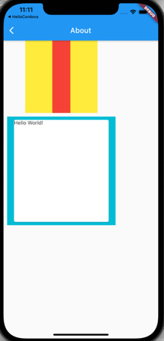
Container Example
Container(
color: Colors.cyan,
margin: EdgeInsets.all(10),
padding: EdgeInsets.symmetric(horizontal: 15, vertical: 5),
height: 300,
width: 300,
child: Card(child: Text('Hello World!')),
)
Try the codes in about.dart. You will need Column() widget to arrange it like this image

Slide 14
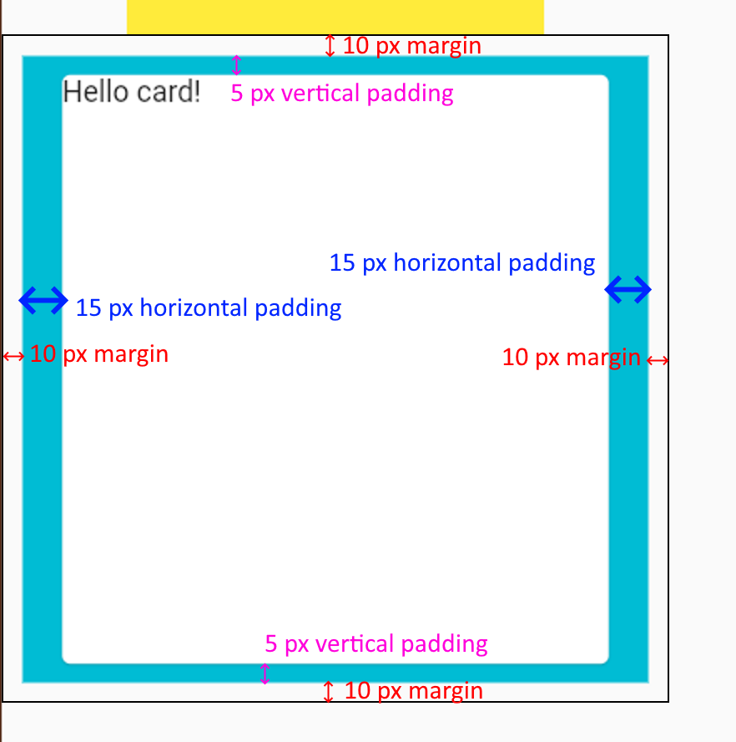
EdgeInsets in action
Container(
color: Colors.cyan,
margin: EdgeInsets.all(10),
padding: EdgeInsets.symmetric(
horizontal: 15, vertical: 5),
height: 300,
width: 300,
child: Card(child: Text('Hello World!')),
)

Slide 15
BoxDecoration class
Provides a variety of ways to draw a box
It has a border, a body, and may cast a shadow (boxShadow)
Box may be a circle or a rectangle
borderRadius property specify the roundness of the corner
Constructed as layers (from bottom to top):
Color (fills the box)
Gradient (fills the box)
Image (alignment is controlled by DecorationImage class)
Border paint over the body, the shadow below it

Slide 16
BoxDecoration properties
border → BoxBorder?
A border to draw above the background color, gradient, or image.
borderRadius → BorderRadiusGeometry?
If non-null, the corners of this box are rounded by this BorderRadius.
boxShadow → List<BoxShadow>?
A list of shadows cast by this box behind the box.
color → Color?
The color to fill in the background of the box.
gradient → Gradient?
A gradient to use when filling the box.
image → DecorationImage?
An image to paint above the background color or gradient.
shape → BoxShape The shape to fill the background color, gradient, and image into and to
cast as the boxShadow

Slide 17
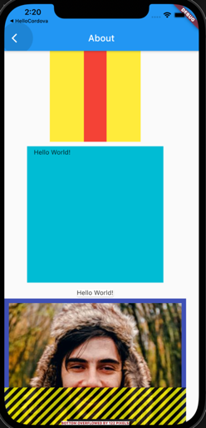
BoxDecoration Example
Container(
width: 400,
height: 400,
decoration: BoxDecoration(
image: DecorationImage(
image: NetworkImage('https://i.pravatar.cc/400?img=60'),
fit: BoxFit.cover,
),
border: Border.all(
color: Colors.indigo,
width: 10,
),
),
)
There are warning sign because some portion of container outside the screen.
--> Wrap Column with SingleChildScrollView

Slide 18
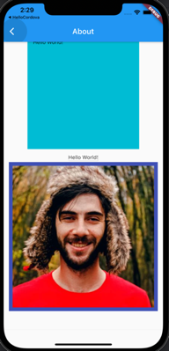



BoxDecoration Example (2)
shape: BoxShape.circle
shape: BoxShape.rectangle,
borderRadius: BorderRadius.all(Radius.circular(60))),
boxShadow: [
BoxShadow(blurRadius: 30, color: Colors.black)],

Slide 19
MULTI CHILD LAYOUT WIDGET
02

Slide 20
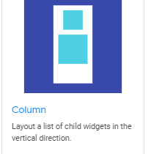
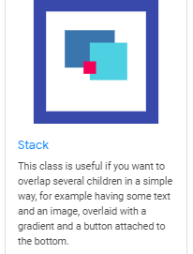
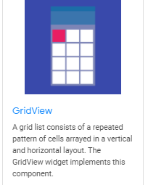
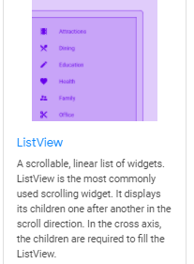
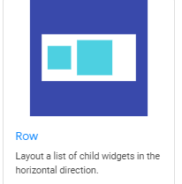
Multi Child Layout Widget

Slide 21
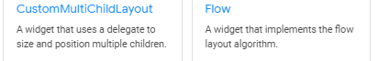
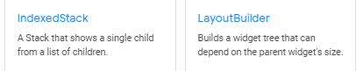
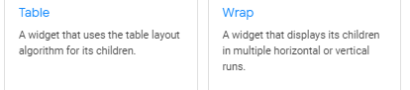
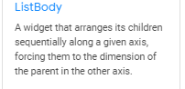
Multi Child Layout Widget (2)

Slide 22
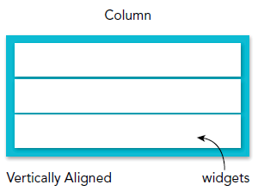
Column
Displays the children vertically
The property requires a List<Widget>
Children are aligned vertically without taking full height of the screen
Each child may be embedded within an Expanded widget to fill in available space
To align and size how much space is occupied on the main axis, use CrossAxisAlignment, MainAxisAlignment, and MainAxisSize
Column( children: <Widget>[ Text(‘text baris 1'), Text(‘text baris 2'),
] )

Slide 23
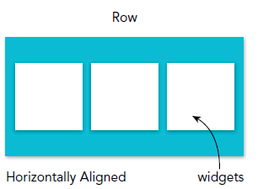
Row
Similar to Column, but displays its children horizontally
Properties are the same as Column widget
Row( children: <Widget>[ Text(‘text kolom 1'), Text(‘text kolom 2'),
] )

Slide 24
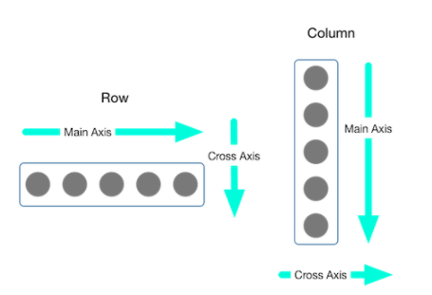
mainAxisSize property
Row and Column occupy different main axes: Row = horizontal, Column = vertical
mainAxisSize property determines how much space a Row and Column can occupy on their main axes
Two possible values:
MainAxisSize.max
Row/Column occupies all the space on the main axis
If the combined width of the children < total space on main axis, the children will be laid out with extra spaces
MainAxisSize.min
Row/Column only occupies enough space on the main axis
Children are laid out without extra space, at the middle of the main axes

Slide 25
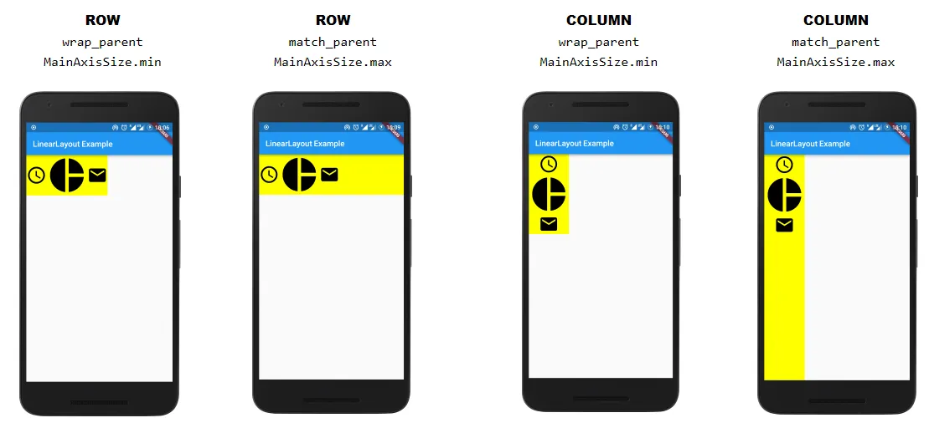

Slide 26
mainAxisAlignment property
Determines how Row/Column can position their children in that extra space. Possible values:
MainAxisAlignment.start Positions children near the beginning of the main axis. (Left for Row, top for Column)
MainAxisAlignment.end
Positions children near the end of the main axis. (Right for Row, bottom for Column)
MainAxisAlignment.center
Positions children at the middle of the main axis.
MainAxisAlignment.spaceBetween
Divides the extra space evenly between children.
MainAxisAlignment.spaceEvenly
Divides the extra space evenly between children and before and after the children.
MainAxisAlignment.spaceAround
Similar to MainAxisAlignment.spaceEvenly, but reduces half of the space before the first child
and after the last child to half of the width between the children.

Slide 27
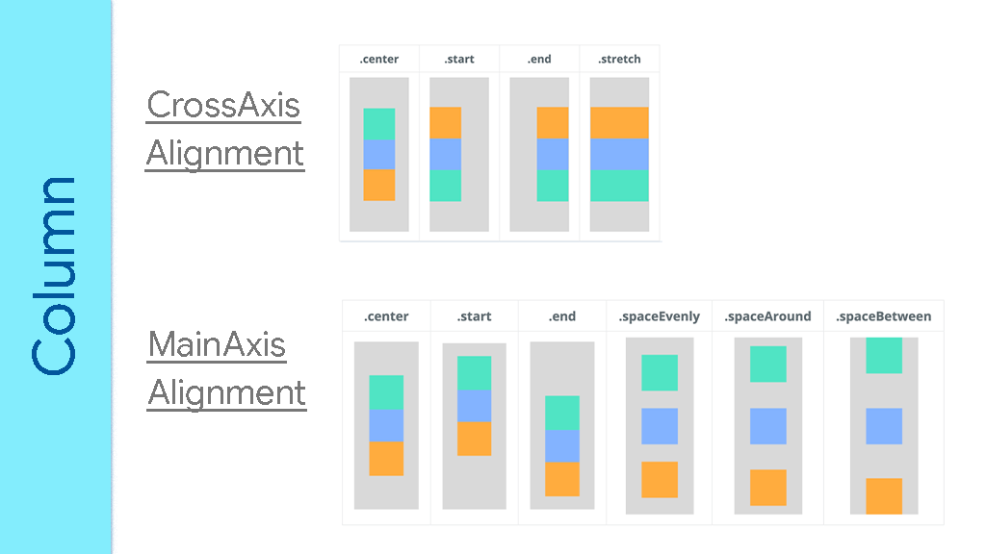

Slide 28
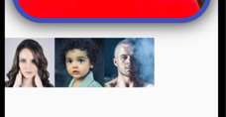
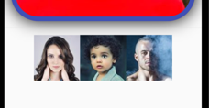
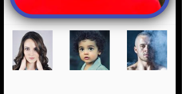
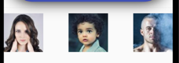
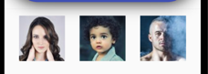
Row
Row(
mainAxisAlignment: MainAxisAlignment.start,
children: [
Image.network('https://i.pravatar.cc/100?img=1'),
Image.network('https://i.pravatar.cc/100?img=2'),
Image.network('https://i.pravatar.cc/100?img=3'),
],
)
----
mainAxisAlignment: MainAxisAlignment.center
mainAxisAlignment: MainAxisAlignment.spaceAround
mainAxisAlignment: MainAxisAlignment.spaceBetween
mainAxisAlignment: MainAxisAlignment.spaceEvenly

Slide 29
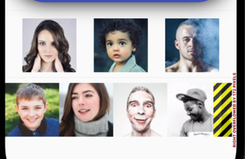
Row (2)
Divider(
height: 20,
),
Row(
mainAxisAlignment: MainAxisAlignment.spaceEvenly,
children: [
Image.network('https://i.pravatar.cc/100?img=4'),
Image.network('https://i.pravatar.cc/100?img=5'),
Image.network('https://i.pravatar.cc/100?img=6'),
Image.network('https://i.pravatar.cc/100?img=7'),
Image.network('https://i.pravatar.cc/100?img=8'),
Image.network('https://i.pravatar.cc/100?img=9'),
],
),
can you resolve this?

Slide 30
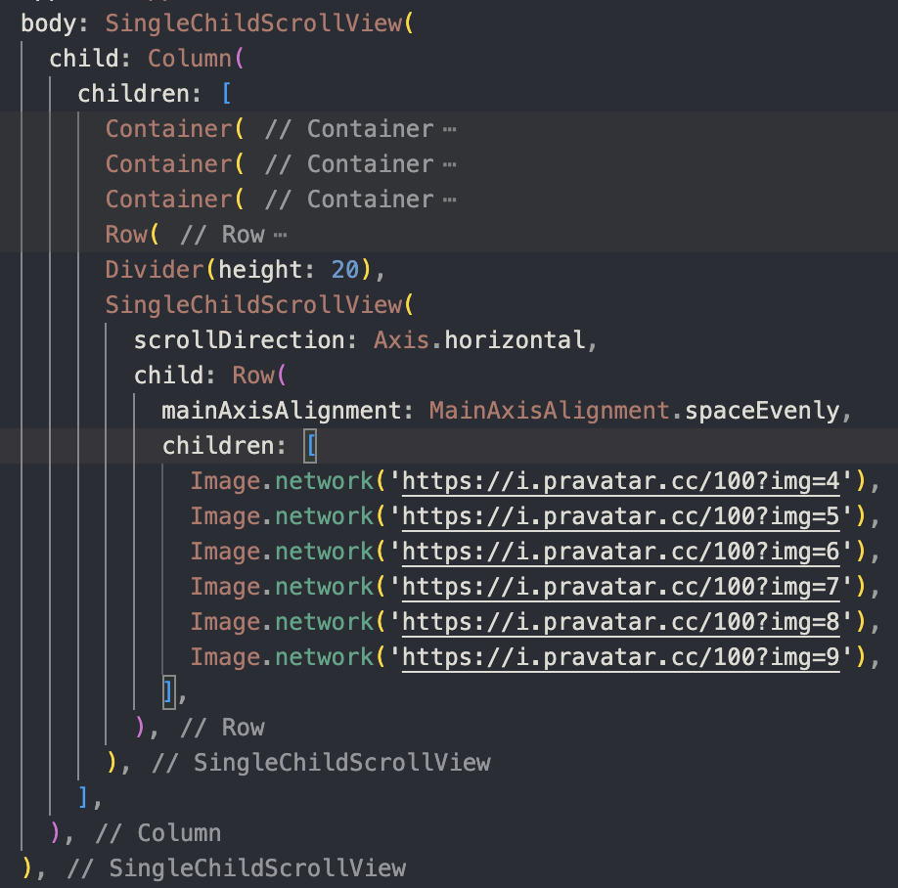
Solution
scrollDirection property will make content of SingleChildScrollView have vertical scroll instead of horizontal

Slide 31
Stack
Positions its children relative to the edges of its box.
Useful to simply overlap several children, e.g. overlay some text over an image with a gradient and button at bottom
Each child is either positioned or non-positioned:
Positioned children are wrapped in a Positioned widget, with at least one non-null property
Stack sizes to contain all non-positioned children, which will be positioned according to default alignment (top-left corner for LTR environment, top-right corner for RTL)
Positioned children are placed relative to the stack according to top, right, bottom, and left properties

Slide 32
Image
To specify an image, use one of the following constructors:
Image: obtaining an image from an ImageProvider
Image.asset: obtaining an image from an AssetBundle using a key
An Asset image will be bundled along with the code in the apk file
Image.network: obtaining an image from a URL
Image.file: obtaining an image from a File
Image.memory: for obtaining an image from a Uint8List

Slide 33
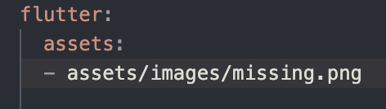
Stack example
We will create Two stacked Images. The first image will use network and the second image will use asset.
Asset image preparation:
Copy missing.png image from ULS,
paste in assets/images folder.
(create in the same
parent directory with lib folder).
Open pubspec.yaml file.
Modify as shown.
Save.
You need to quit and rerun flutter in terminal!

Slide 34
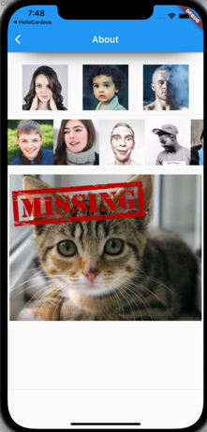
Stack example (2)
Stack(
children: [
Image.network("https://placecats.com/neo/300/200"),
Image.asset("../assets/images/missing.png")
],
),
Can you modify it, so the cat image have a rounded corner and the “missing” text placed in the bottom center?

Slide 35
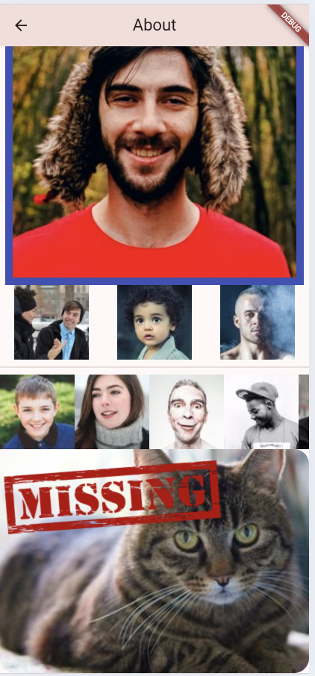
Solution
Stack(
children: [
Container(
width: double.infinity, // stretch
height: 300,
decoration: BoxDecoration(
shape: BoxShape.rectangle,
borderRadius: BorderRadius.all(
Radius.circular(20),
), // rounded corners
image: DecorationImage(
image: NetworkImage("https://placecats.com/neo/300/200"),
fit: BoxFit.cover, // aspect ratio dijaga
),
),
),
Image.asset("../assets/images/missing.png")
],
),
Salah satu solusi adalah menggunakan BoxDecoration dan borderRadius

Slide 36
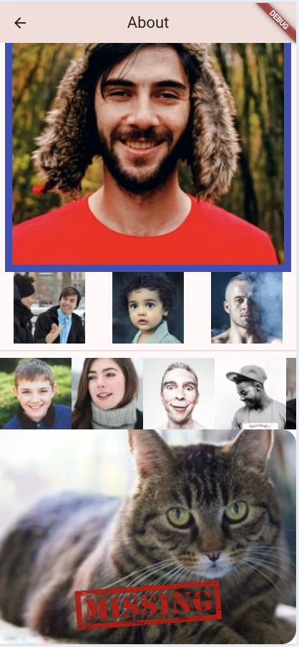
Solution
Stack(
children: [
Container(
. . .
),
Positioned(
bottom: 0,
left: 0,
right: 0,
child: Image.asset(
"../assets/images/missing.png",
height: 100,
fit: BoxFit.contain,
),
),
],
),
Check this for more information about Positioned
https://youtu.be/EgtPleVwxBQ?si=0EI5Us31J92iNpXi

Slide 37
GridView
Similar as GridView widget in native Android apps
Main axis direction (to where it will scroll) is specified in scrollDirection property
Most commonly-used grid layouts:
GridView.count: creates a layout with fixed number of tiles in the cross axis
GridView.extent: creates a layout with tiles that have a maximum cross-axis extent
To create a grid with a large (or infinite) number of children, use the GridView.builder
To create a linear array of children, use a ListView.

Slide 38
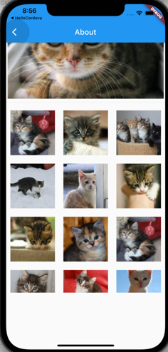
GridView
We will use GridView.count constructor to show grid of cats image.
The GridView.count need a children in form of List of Widget. We will create a function to generate this List of Widget.
GridView needs a parent which have a size. Therefore we will wrap the Gridview in a container.

Slide 39
GridView Example
We use random function. Dont forget to import the Math library
import 'dart:math';
—----------------
List<Widget> randomphotos() {
List<Widget> temp = [];
int i = 0;
final random = Random();
while (i < 15) {
int randomNumber = random.nextInt(1084) + 1;
Widget w = Image.network(
"https://picsum.photos/id/$randomNumber/200/200",
);
temp.add(w);
i++;
}
return temp;
}
Check SizeBox here: https://youtu.be/EHPu_DzRfqA?si=9icYcVtbz7bE6CbZ
body: SingleChildScrollView(
child: Column(
children: [
. . ., SizedBox(
height: 500,
child: GridView.count(
crossAxisCount: 3,
children: randomphotos(),
),
),
]
)
)
We use image placeholder from picsum. It requires an id number to display specific photo

Slide 40
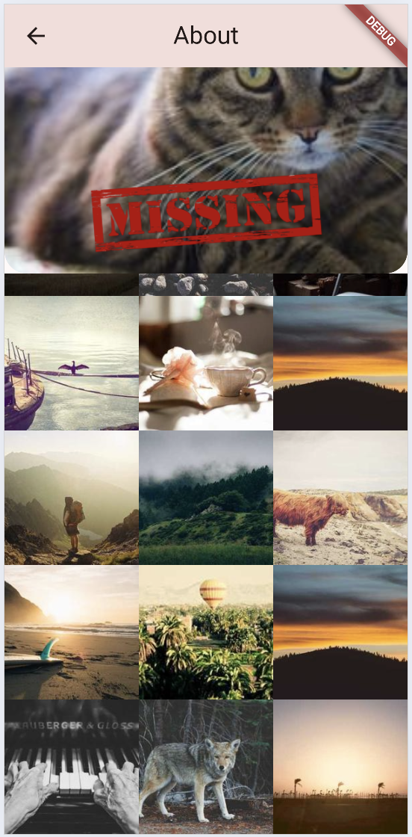
Result

Slide 41
EXERCISE
03

Slide 42
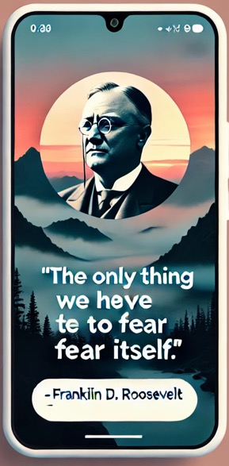
Exercise
Make your Home page as a quote page.
It displays a quote with background image, and the person who has the quote.
Upload to ULS - home.dart - capture of home screen when running

Slide 43



